Slide 1
Comparative Analysis of Machine Learning Algorithms using Credit Scoring Data
Presented by
Muhammad Omar Waqar
M.Sc. Big Data Science
2018

Slide 2
Introduction
What this project is about?
Analysis of three classification algorithms on consumer credit scoring data.
Kaggle competition : Home Credit Default Risk by Home Credit Group.

Slide 3
ML in Credit Scoring
Corporate Credit
Consumer Credit
Regression (Credit Score)
Classification (Probability to default)
Notes:
Difficulty in repayment.

Slide 4
ML in Credit Scoring
Corporate Credit
Consumer Credit
Regression (Credit Score)
Classification (Probability to default)
Notes:
Difficulty in repayment.

Slide 5
Introduction (Contd.)
How is consumer credit data different
Tries to capture consumer demographics and their financial behavior.

Slide 6
Introduction (Contd.)
How is consumer credit data different
Tries to capture consumer demographics and their financial behavior.
Features vary company to company and are sparsely filled
Age distributions
Occupations
etc..
Repayment history
Annual income
etc..
Notes:
Example: Who accompanied the applicant at the time of applying or the day the applicant applied on.
This makes data sets more unique and different from each other.

Slide 7
Motivation
Existing studies:
General comparison on multiple datasets
Suggesting novel approaches
No study suggesting in-depth analysis
General approach on Kaggle: trail and error
Notes:
Selection of most suitable algorithm based on characteristics of the data set.

Slide 8

Motivation (Contd.)
Source : http://scikit-learn.org/stable/tutorial/machine_learning_map/index.html
Notes:
Sklearn has presented a more general approach but this is what has been used by people on the Kaggle competition as well.

Slide 9
Motivation (Contd.)
Nothing related to dataset other than it’s size.
Source : http://scikit-learn.org/stable/tutorial/machine_learning_map/index.html
Notes:
How presentation will benefit audience: Adult learners are more interested in a subject if they know how or why it is important to them.
Presenter’s level of expertise in the subject: Briefly state your credentials in this area, or explain why participants should listen to you.

Slide 10
About this Project:
How is in-depth analysis conducted:
Produce variants of the same data with different transformations.
Get the results for a common matric.
Analyse those results in light of the characteristics of that dataset variant.
Notes:
I have not mentioned the EDA or Data cleaning and other steps because they were not relevant to this presentation.
Transformations : Categorical values handling, Null Values handling.

Slide 11
Methodology
Algorithms
Logistics Regression
Linear SVC
LightGBM
Performance metric
ROC-AUC.
Notes:
LR because it is still widely used according to the studies.
Linear SVC because SVC a powerful classifier.
LGBM because its popular

Slide 12
Methodology
 | File Version | Sub - version
 |  | Without Categorical Features | With Categorical Features OHE | With Categorical Features WoE Enc.
Data with null values | 1 | a | b | c
Data without null values | 2 | a | b | c
Data with null values imputed | 3 | a | b | c
With null values imputed and scaled | 4 | a | b | c
With feature selection | 5 | a | b | c
Subset with balanced samples | 6 | X | a | X
Subset with stratified samples | 6 | X | b | X
Data Variations:
Data transformations
Encoding of categorical features
Notes:
Supplementary table to interpret the results table.
1-a:[307507, 79] , b: [307507,260] , c: [307507,121]
2-a: [10745, 79] , b: [8602, 260], c: [8602, 121]
3-a: [307507, 79], b: [307507, 244] , c: [307507,121]
4-a: [307507, 79], b: [207507,244], c: [307507, 121]
5-a: [307507, 48(42num)], b: [307507, 120(100num)], c: [307507, 59(43num)]
6-a: [49650, 244] , b: [49650, 244] ,

Slide 13
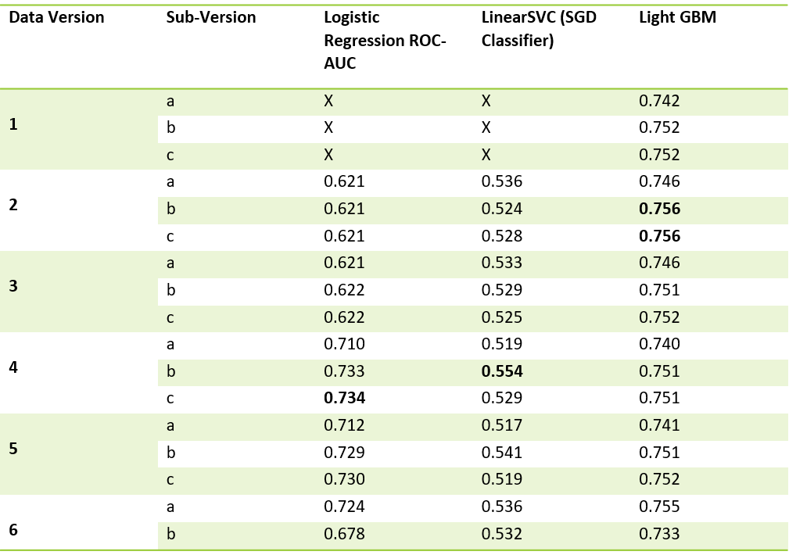
Results
Notes:
LR: Two conclusions shown.
SVC: Behavior changes when values are scaled.
LGBM: Not effected by the way categorical values are handled
Sampling results: LR effected most by imbalance then LGBM then SVC.

Slide 14
Results
Notes:
LR: Two conclusions shown.
SVC: Behavior changes when values are scaled.
LGBM: Not effected by the way categorical values are handled
Sampling results: LR effected most by imbalance then LGBM then SVC.

Slide 15
Results
Not effected by larger dataset
Notes:
LR: Two conclusions shown.
SVC: Behavior changes when values are scaled.
LGBM: Not effected by the way categorical values are handled
Sampling results: LR effected most by imbalance then LGBM then SVC.

Slide 16
Results
Notes:
LR: Two conclusions shown.
SVC: Behavior changes when values are scaled.
LGBM: Not effected by the way categorical values are handled
Sampling results: LR effected most by imbalance then LGBM then SVC.

Slide 17
Results
Scaling features has a huge effect.
Notes:
LR: Two conclusions shown.
SVC: Behavior changes when values are scaled.
LGBM: Not effected by the way categorical values are handled
Sampling results: LR effected most by imbalance then LGBM then SVC.

Slide 18
Conclusions:
Logistic regression is sensitive to numerical features and scaling.
LinearSVC can work well with data sparsity.
LightGBM is not effected by type of encoding.
Other interesting conclusions can be seen in the project report.
Notes:
LR: Two conclusions shown.
SVC: Behavior changes when values are scaled.
LGBM: Not effected by the way categorical values are handled
Sampling results: LR effected most by imbalance then LGBM then SVC.

Slide 19
Future work
Multiple datasets.
Study more algorithms.
More transformation techniques to vary inputs to training.

Slide 20
Code Demonstration - Jupyter notebook.
Notes:
Lesson descriptions should be brief.

Slide 21
Thank You.
Notes:
Lesson descriptions should be brief.

